Slide 1
CS6382 Algorithm Analysis and Game Theory
Fair Division
adapted from Xiaohui Bei and Bo Li’s slides

Slide 2

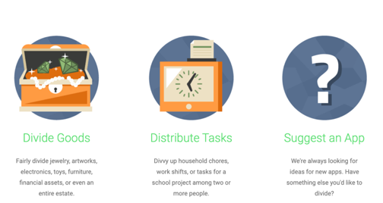
Fair Resource Allocation
Spliddit.org

Slide 3


Fair Resource Allocation
Divisible
Indivisible

Slide 4

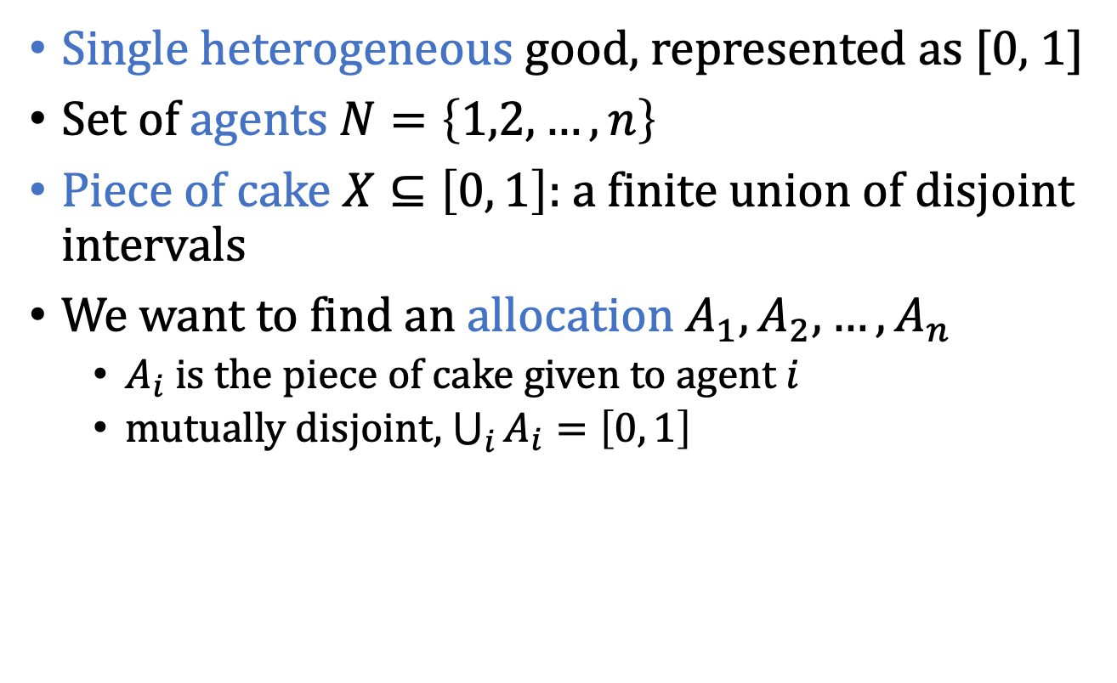
Divisible Resource – Cake Cutting
Single heterogeneous good, represented as [0, 1]
Set of agents $N=\left\{1,2,…,n\right\}$
Piece of cake $X⊆\left[0, 1\right]:$a finite union of disjoint intervals
We want to find an allocation $A_{1},A_{2},…, A_{n}$
$A_{i}$ is the piece of cake given to agent $i$
mutually disjoint, $\bigcup_{i}{A_{i}}=\left[0, 1\right]$

Slide 5

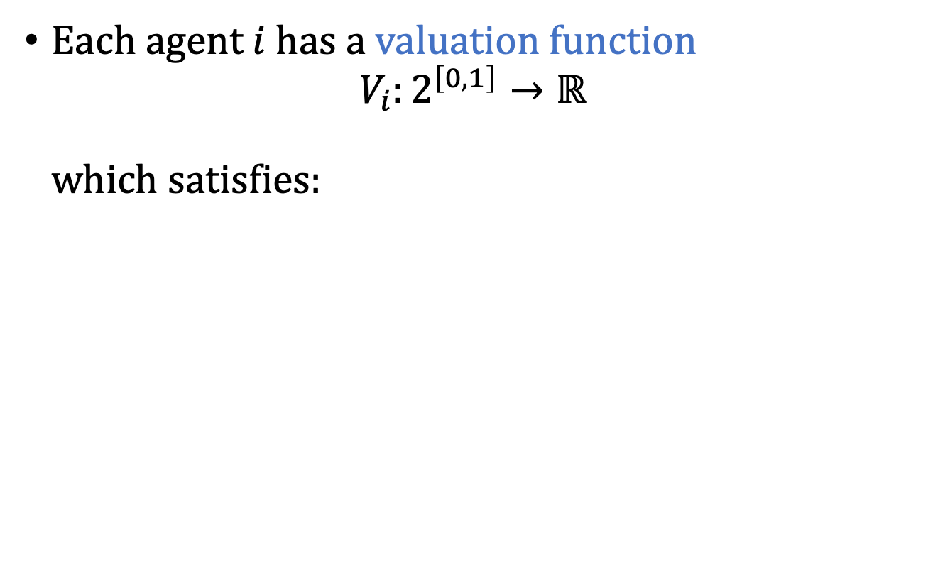

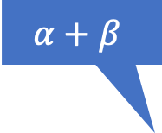


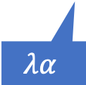
Valuation
Each agent $i$ has a valuation function $V_{i}:2^{\left[0,1\right]}→ℝ$ which satisfies:
$$α+β$$
$$1$$
$$α$$
$$α$$
$$β$$
$$λα$$
Additive
Normalized
Divisible

Slide 6

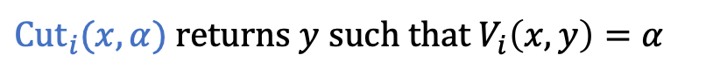
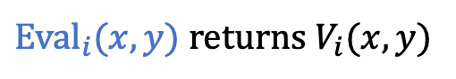
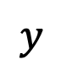
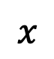
Complexity
Inputs are functions
may need infinitely many bits to fully represent the input
query complexity is more useful
Robertson-Webb Model
${Eval}_{i}(x,y)$ returns $V_{i}(x,y)$
$$α$$
Eval output
$$x$$
$$y$$
Cut output
$Cut_{i}(x,α)$ returns $y$such that $V_{i}\left(x,y\right)=α$

Slide 7
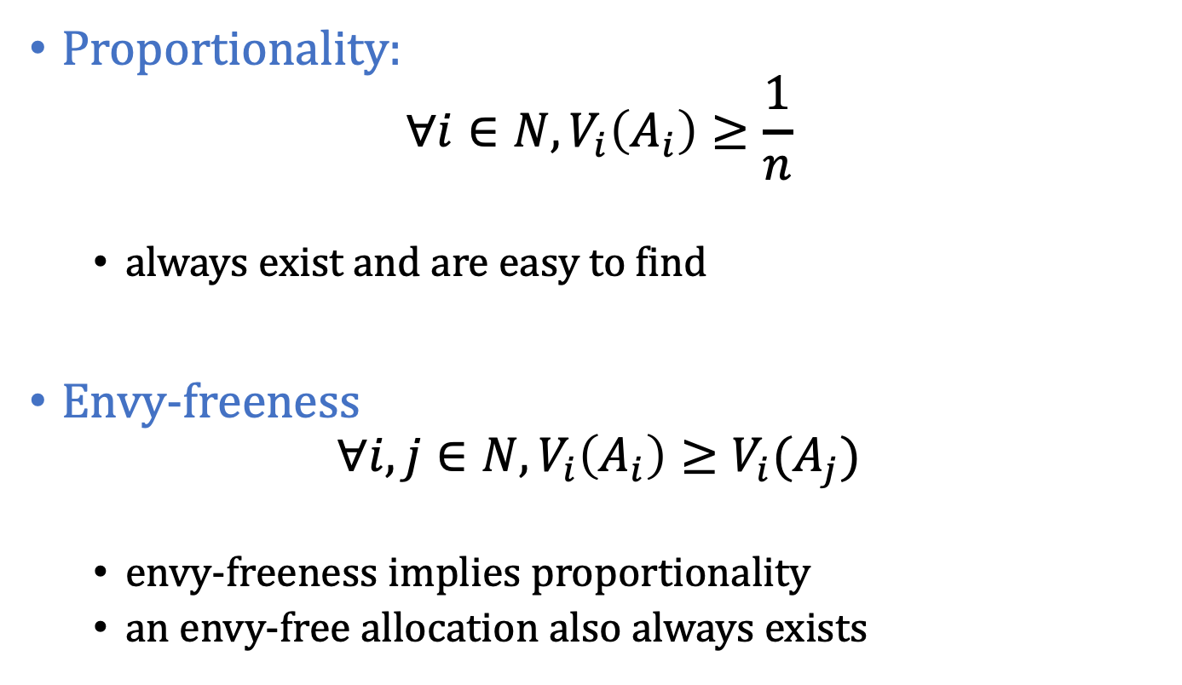
Fairness Properties
Proportionality:
$$∀i∈N, V_{i}\left(A_{i}\right)≥\frac{1}{n}$$
always exist and are easy to find
Envy-freeness
$$∀i, j∈N, V_{i}\left(A_{i}\right)≥V_{i}(A_{j})$$
envy-freeness implies proportionality
an envy-free allocation also always exists

Slide 8

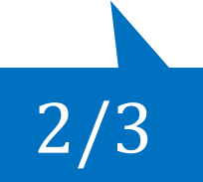
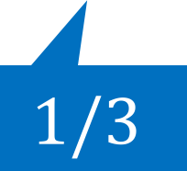


Cut and Choose
$$1/2$$
$$1/2$$
$$1/3$$
$$2/3$$

Slide 9
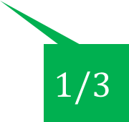
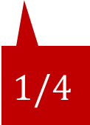
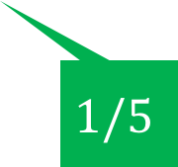
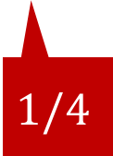
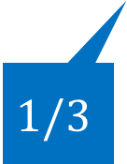

Dubins-Spanier Protocol “Moving Knife” Procedure
$$1/3$$
$$1/4$$
$$1/5$$
$$1/4$$
$$1/3$$
$$1/2$$

Slide 10
Cake Cutting is not a Piece of Cake
[Selfridge–Conway procedure, around 1960]: A discrete envy-free procedure for 3 players.
[Brams and Taylor, 1995]: An unbounded (but finite) envy-free protocol for any number of players.
[Aziz and Mackenzie, STOC 2016]: A discrete and bounded envy-free cake cutting protocol for four players.
[Aziz and Mackenzie, FOCS 2016]: A discrete and bounded envy-free cake cutting protocol for any number of players.

Slide 11
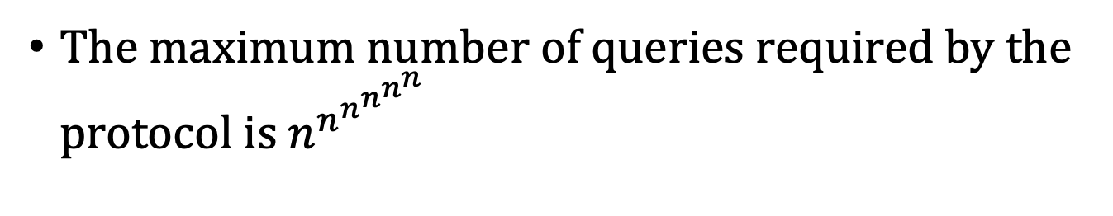
End of story?
The maximum number of queries required by the protocol is $n^{n^{n^{n^{n^{n}}}}}$
Open Question: Towards a practical EF protocol
Design an EF protocol with a smaller number of cuts.

Slide 12

Incentive

Slide 13




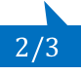

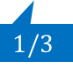



Truthful Cake Cutting
When following a cake-cutting protocol, players may gain from manipulation.
Cut and Choose: player 1 can manipulate
Dubins-Spanier: shout later
$$1/2$$
$$1/2$$
$$1/3$$
$$2/3$$
$$1/3$$
$$1/4$$
$$1/5$$
$$1/4$$
$$1/3$$

Slide 14
Truthful Cake Cutting
A cake cutting mechanism is truthful if reporting the truth is a dominant strategy
Player does not gain by lying in any situation
Goal: design deterministic, truthful and fair cake cutting mechanisms.

Slide 15
Difficulties
[Kurokawa, Lai, Procaccia, 2013]:
There exists no truthful, envy-free mechanism with bounded number of queries under the Robertson-Webb model.
Restrict the valuation functions
Let players report full valuations

Slide 16
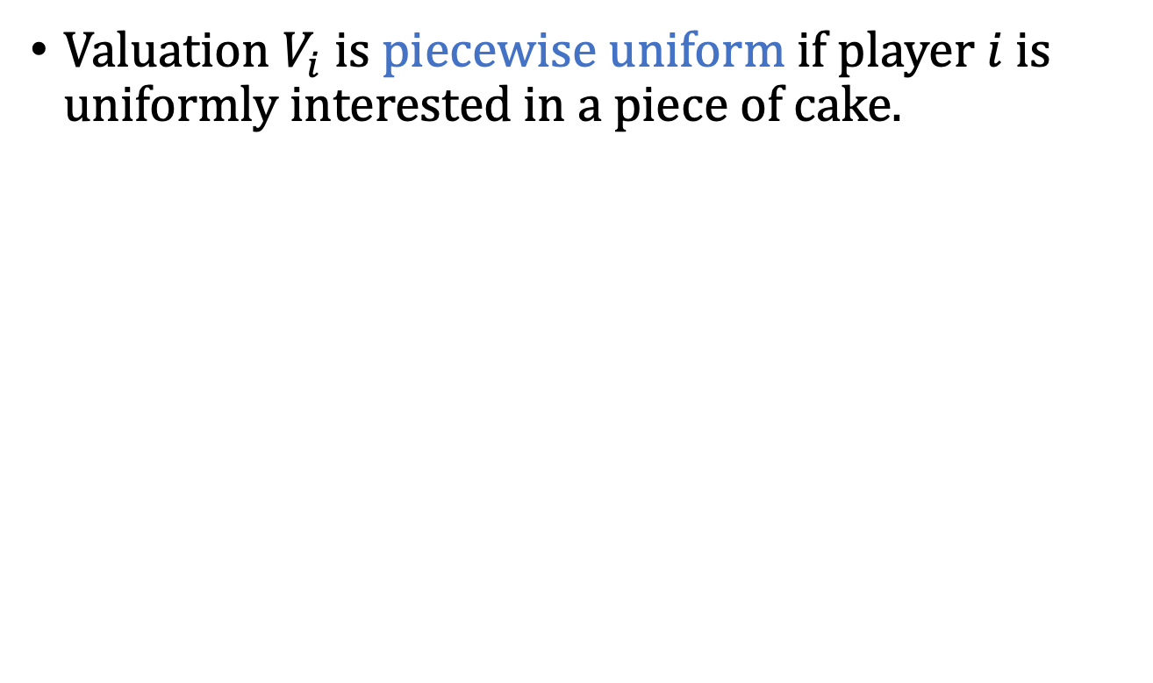
Piecewise Uniform Valuations
Valuation $V_{i}$ is piecewise uniform if player $i$ is uniformly interested in a piece of cake.

Slide 17
Positive News
[Chen, Lai, Parkes, Procaccia, 2010]: When players have piecewise uniform valuations, there is a deterministic, truthful and envy-free cake cutting mechanism.
Mechanism:
Discard pieces that are not valued by any player.
Iteratively compute the best allocation.
[Li, Zhang, Zhang, 2015]
Adding externality

Slide 18
Free Disposal
Free Disposal Assumption:
The mechanism is allowed to throw away part of the resource without incurring any cost.
A pivotal assumption assumed in all previous works.
Does not apply in certain scenarios.
divide a piece of land among antagonistic agents or countries
Does not apply to chore division.
one might as well throw away the whole chore!
Goal: can we design deterministic, truthful and fair cake cutting mechanisms without the free disposal assumption?

Slide 19
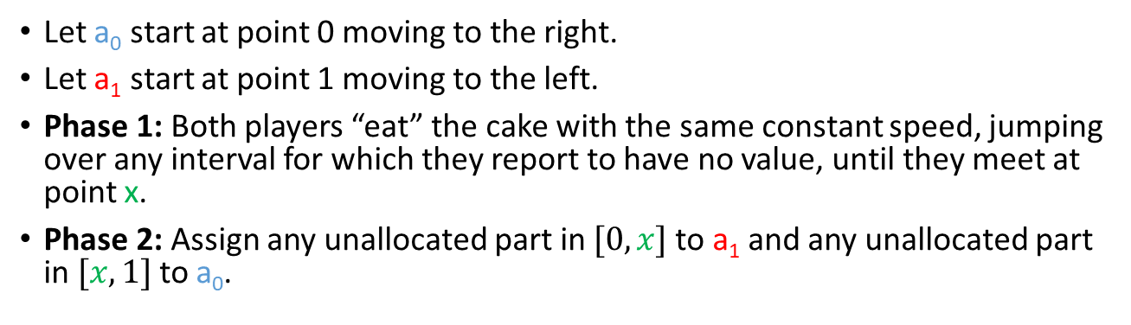
A Truthful Mechanism for 2 Players
Let a₀ start at point 0 moving to the right.
Let a₁ start at point 1 moving to the left.
Phase 1: Both players “eat” the cake with the same constant speed, jumping over any interval for which they report to have no value, until they meet at point x.
Phase 2: Assign any unallocated part in $[0,x]$ to a₁ and any unallocated part in $[x, 1]$ to a₀.
Theorem [B, Huzhang, Suksompong, 2018]:
The mechanism is a truthful, envy-free, and Pareto optimal cake cutting mechanism for two players.

Slide 20
Proof
Truthfulness:
Players do not want to report an interval that they do not value.
Players do not want to not report some valued intervals
the intervals that a player jumps over before meet will be lost to the other player
extra time gained from not reporting these intervals can be used to eat extra intervals of no more than the same length
Envy-freeness:
each player gets at least half of her valued intervals allocated in each phase.
Pareto optimality:
this mechanism always allocates any interval valued by at least one agent to an agent who values it.

Slide 21
Challenge
Open Question:
Show the (non)existence of truthful and envy-free mechanisms for 3 or more players with piecewise uniform valuations without the free disposal assumption.

Slide 22
Beyond Piecewise Uniform Valuations
Piecewise constant valuations
Approximate general functions

Slide 23
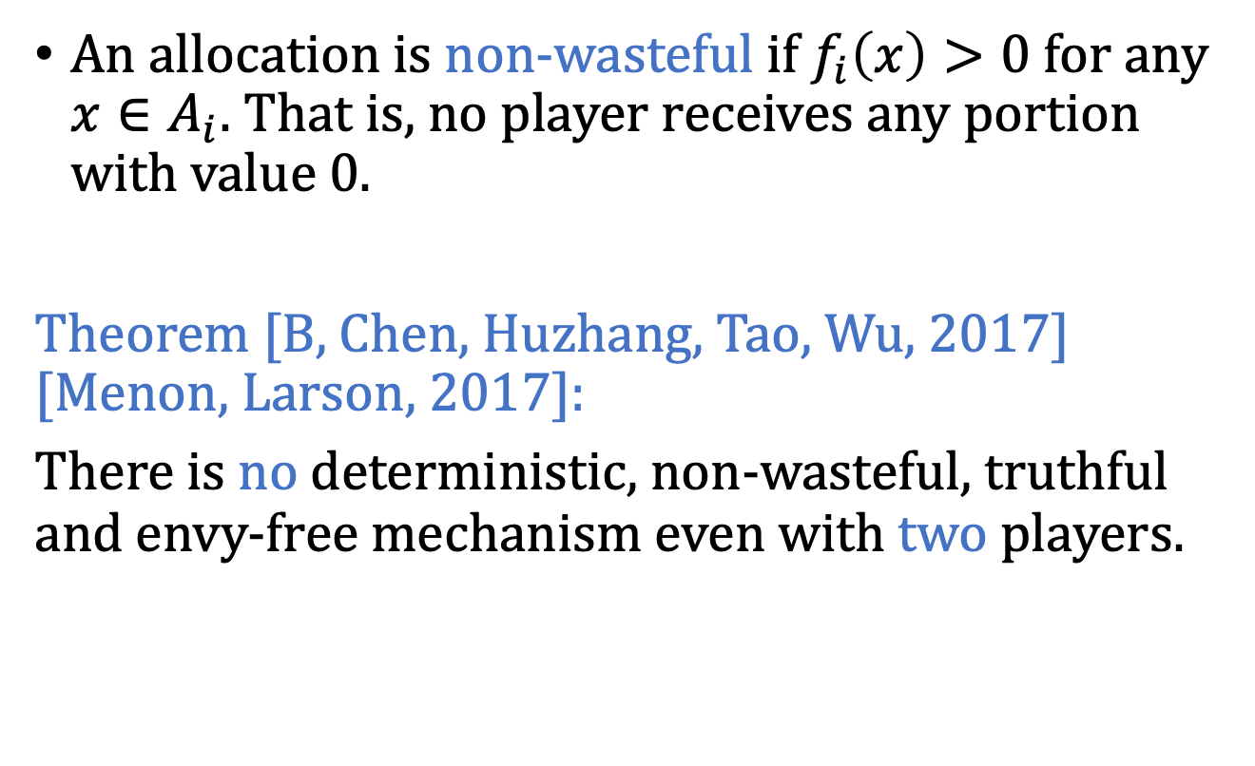
Two Negative Results
An allocation is non-wasteful if $f_{i}\left(x\right)>0$ for any $x∈A_{i}$. That is, no player receives any portion with value 0.
Theorem [B, Chen, Huzhang, Tao, Wu, 2017] [Menon, Larson, 2017]:
There is no deterministic, non-wasteful, truthful and envy-free mechanism even with two players.

Slide 24
Position Oblivious
A mechanism is position oblivious if the values that the players receive depend only on the lengths of the pieces desired by various subsets of players and not on the positions of these pieces.
Theorem [B, Chen, Huzhang, Tao, Wu, 2017]
There is no deterministic, position oblivious, truthful and envy-free mechanism even with two players.

Slide 25
Recent Breakthrough
[Tao, 2021] arXiv: 2104.07387
There is no deterministic, truthful and envy-free mechanism even with two players and piecewise constant valuations.

Slide 26





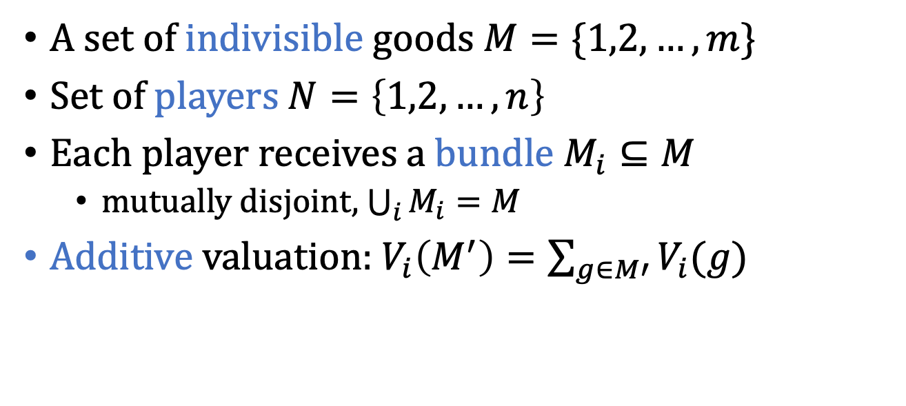
Indivisible Resource
A set of indivisible goods $M=\{1,2,…, m\}$
Set of players $N=\left\{1,2,…,n\right\}$
Each player receives a bundle $M_{i}⊆M$
mutually disjoint, $\bigcup_{i}{M_{i}}=M$
Additive valuation: $V_{i}\left(M^{′}\right)=\sum_{g∈M′}{V_{i}(g)}$

Slide 27

















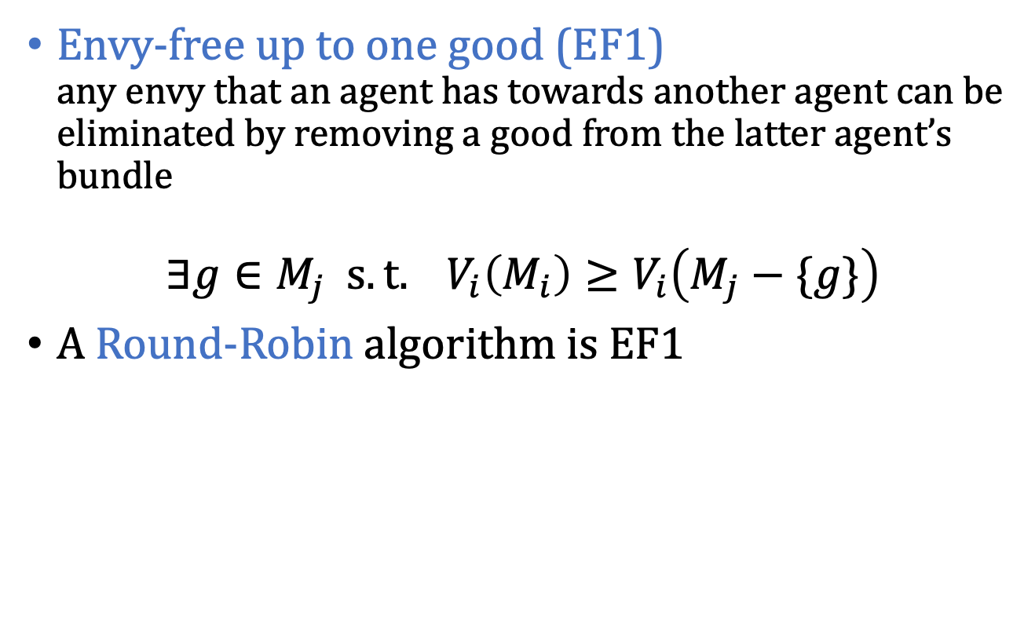
Fairness Concepts
Envy-free up to one good (EF1) any envy that an agent has towards another agent can be eliminated by removing a good from the latter agent’s bundle
$$∃g∈M_{j} s.t. V_{i}\left(M_{i}\right)≥V_{i}\left(M_{j}−\{g\}\right)$$
A Round-Robin algorithm is EF1

Slide 28
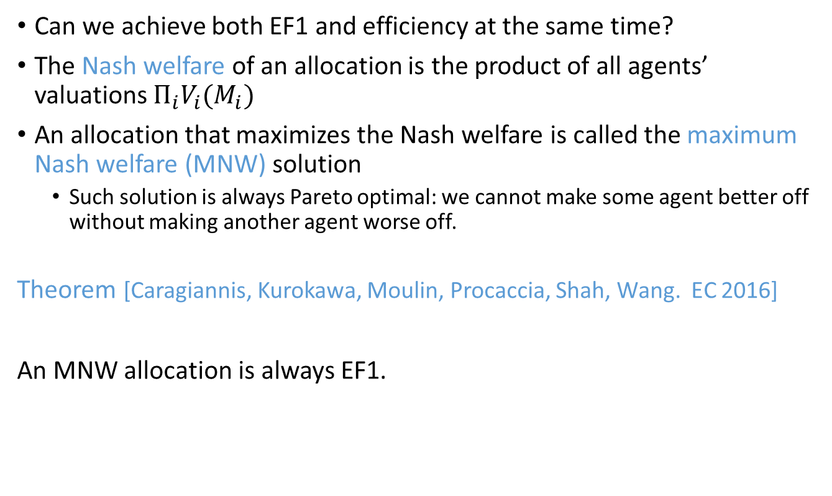
EF1 + Efficiency
Can we achieve both EF1 and efficiency at the same time?
The Nash welfare of an allocation is the product of all agents’ valuations $Π_{i}V_{i}(M_{i})$
An allocation that maximizes the Nash welfare is called the maximum Nash welfare (MNW) solution
Such solution is always Pareto optimal: we cannot make some agent better off without making another agent worse off.
Theorem [Caragiannis, Kurokawa, Moulin, Procaccia, Shah, Wang. EC 2016]
An MNW allocation is always EF1.

Slide 29
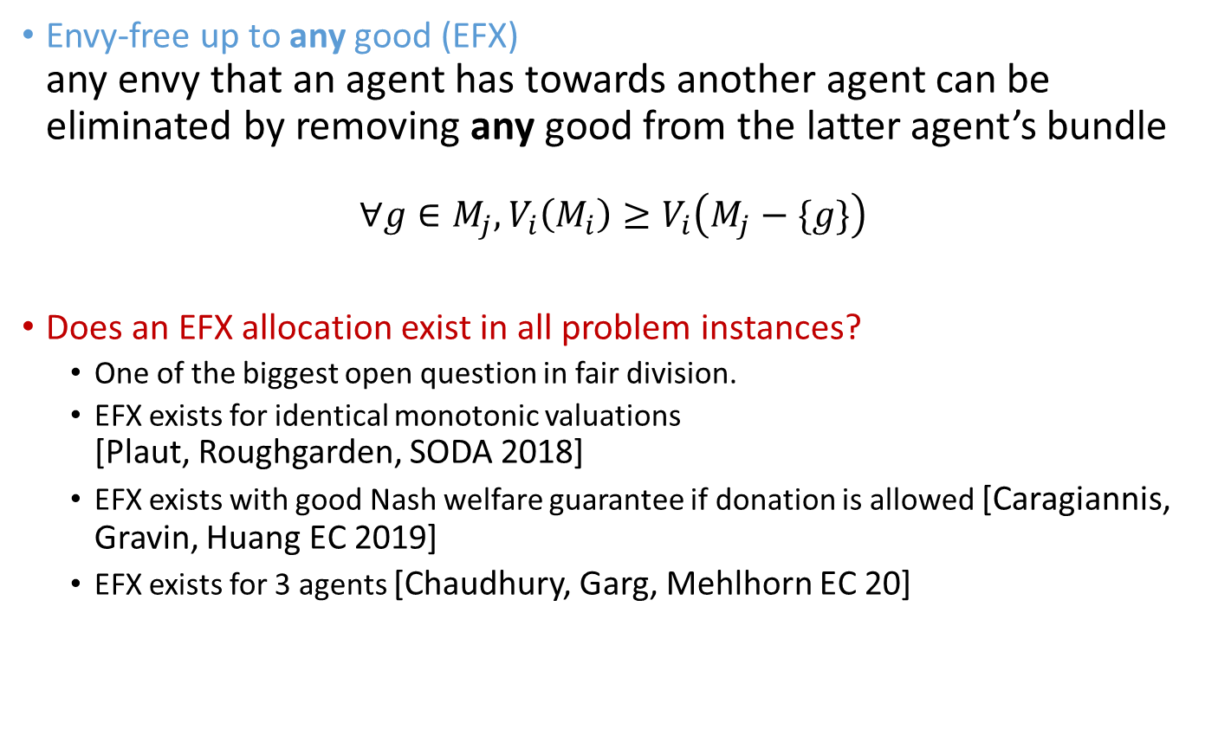
Fairness Concepts
Envy-free up to any good (EFX) any envy that an agent has towards another agent can be eliminated by removing any good from the latter agent’s bundle
$$∀g∈M_{j}, V_{i}\left(M_{i}\right)≥V_{i}\left(M_{j}−\{g\}\right)$$
Does an EFX allocation exist in all problem instances?
One of the biggest open question in fair division.
EFX exists for identical monotonic valuations [Plaut, Roughgarden, SODA 2018]
EFX exists with good Nash welfare guarantee if donation is allowed [Caragiannis, Gravin, Huang EC 2019]
EFX exists for 3 agents [Chaudhury, Garg, Mehlhorn EC 20]

Slide 30





Mixed Goods
Divisible
Envy-freeness
(EF)
Divisible and Indivisible
Indivisible
Envy-freeness up to one good
(EF1)
How do we define fairness with both divisible and indivisible goods?

Slide 31
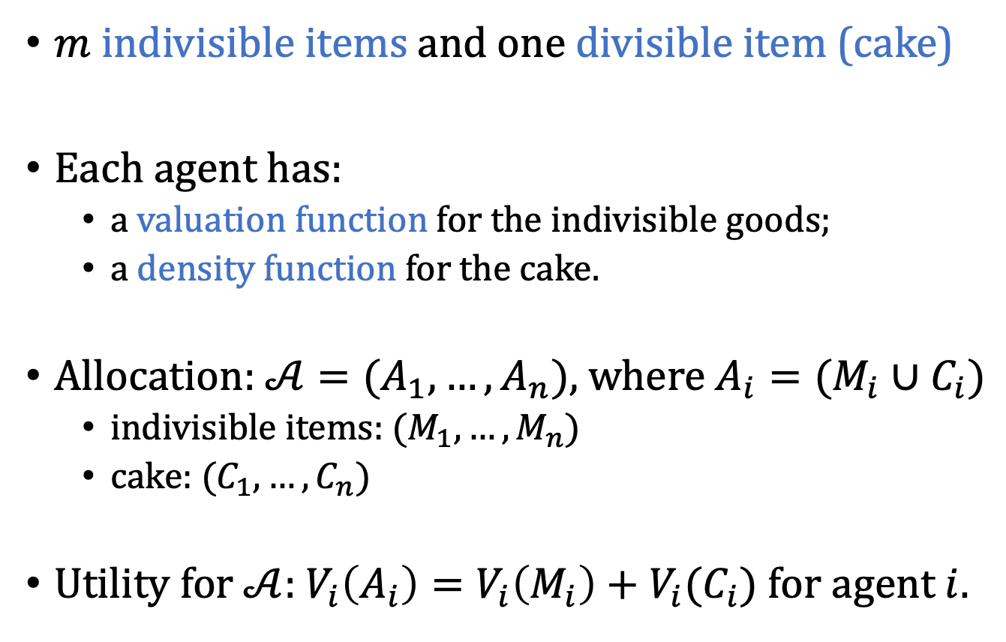
Model
$m$ indivisible items and one divisible item (cake)
Each agent has:
a valuation function for the indivisible goods;
a density function for the cake.
Allocation: $𝒜=(A_{1},…, A_{n})$, where $A_{i}=(M_{i}∪C_{i})$
indivisible items: $(M_{1},…, M_{n})$
cake: $(C_{1},…, C_{n})$
Utility for $𝒜$: $V_{i}\left(A_{i}\right)=V_{i}\left(M_{i}\right)+V_{i}(C_{i})$ for agent $i$.

Slide 32





Envy-Freeness for Mixed Goods
Envy-freeness (EF)?
Envy-freeness up to one good (EF1)?
EF for divisible goods + EF1 for indivisible goods?
$2 | $2
$10

Slide 33
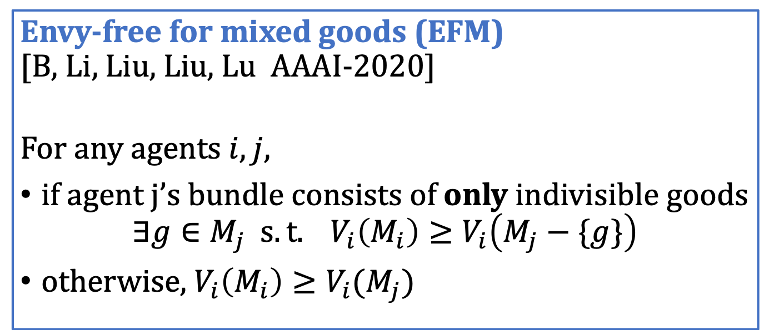
Envy-Freeness for Mixed Goods
Envy-free for mixed goods (EFM) [B, Li, Liu, Liu, Lu AAAI-2020]
For any agents $i, j$,
if agent j’s bundle consists of only indivisible goods
$$∃g∈M_{j} s.t. V_{i}\left(M_{i}\right)≥V_{i}\left(M_{j}−\{g\}\right)$$
otherwise, $V_{i}\left(M_{i}\right)≥V_{i}(M_{j})$
With only divisible goods: EFM reduces to EF.
With only indivisible goods: EFM reduces to EF1.

Slide 34
EFM: Existence
Theorem
An EFM allocation always exists for any number of agents and can be found in polynomial time.
Proof sketch:
Start with an EF1 allocation of indivisible goods
Iteratively (and carefully) add cake
Maintain EFM throughout the process

Slide 35






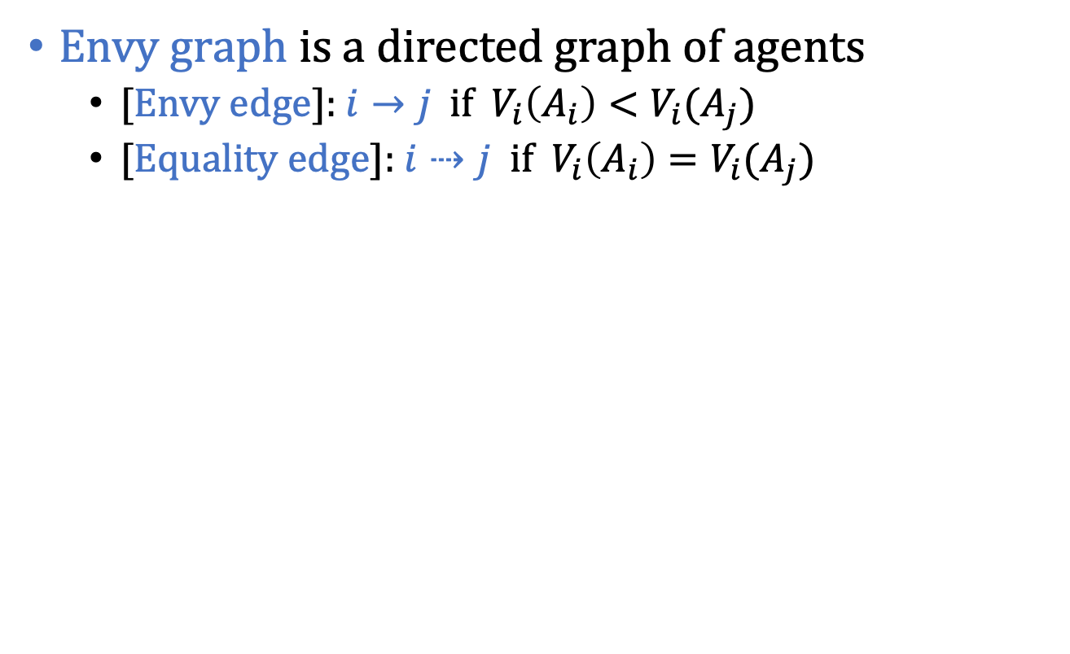
Envy Graph
Envy graph is a directed graph of agents
[Envy edge]: $i→j$ if $V_{i}\left(A_{i}\right)<V_{i}(A_{j})$
[Equality edge]: $i⇢j$ if $V_{i}\left(A_{i}\right)=V_{i}(A_{j})$
 | 4 | 4 | 3
 | 3 | 3 | 4
 | 1 | 4 | 5

Slide 36
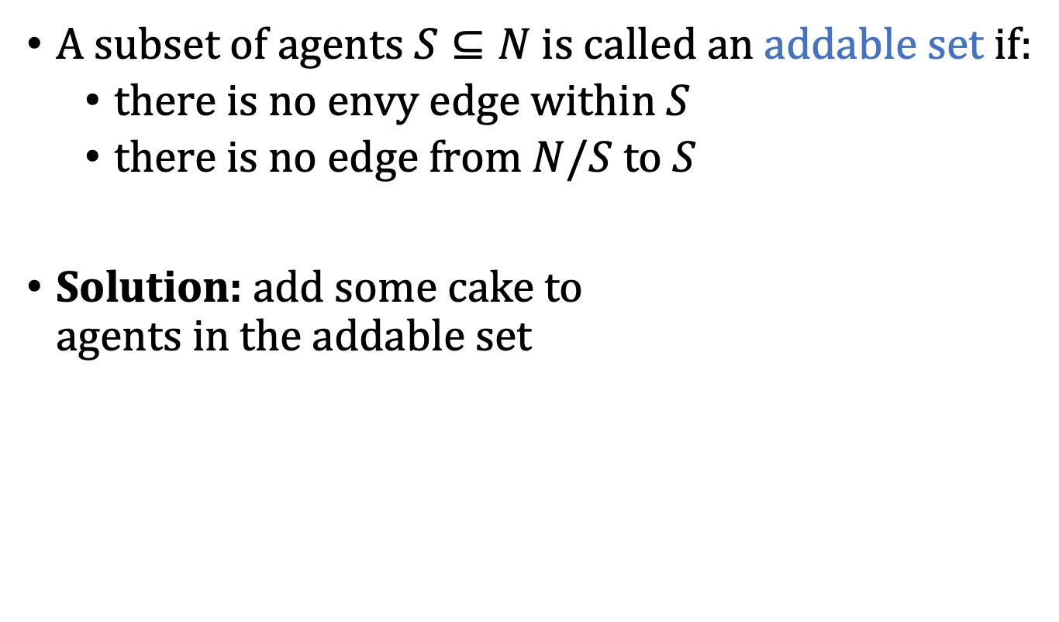


Addable Set
A subset of agents $S⊆N$ is called an addable set if:
there is no envy edge within $S$
there is no edge from $N/S$ to $S$
Solution: add some cake to agents in the addable set
Perfect allocation in cake cutting [Alon, 1987]
In a perfect allocation, every agent thinks all the pieces have the same value.

Slide 37
Envy Cycle
An envy cycle is a cycle in the envy graph with at least one envy edge.
Solution: envy-cycle elimination
assign each agent in the cycle the bundle it points to
at least one envy edge is removed

Slide 38
EFM: Existence
Key Lemma In any envy graph, there exists either an addable set or an envy cycle.
Always make progress
Repeat until all resources are allocated
The process will eventually terminate
The allocation is always EFM

Slide 39
Existence of EFM: Caveat
A polynomial time algorithm if we have a cake-cutting perfect allocation oracle.
Perfect allocation cannot be implemented in the Robertson-Webb (RW) model in bounded time.
Open Question
A bounded EFM protocol in the RW model?

Slide 40
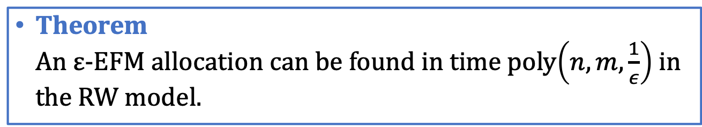
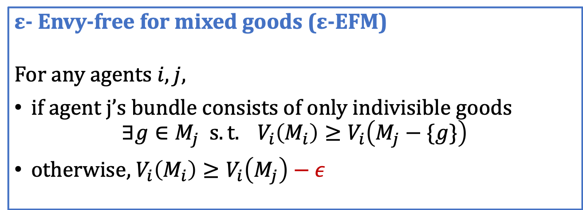
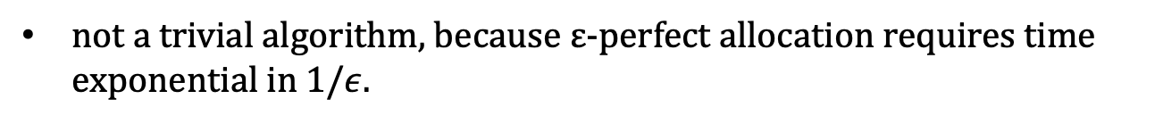
Relaxation of EFM: ε-EFM
ε- Envy-free for mixed goods (ε-EFM) For any agents $i, j$,
if agent j’s bundle consists of only indivisible goods
$$∃g∈M_{j} s.t. V_{i}\left(M_{i}\right)≥V_{i}\left(M_{j}−\{g\}\right)$$
otherwise, $V_{i}\left(M_{i}\right)≥V_{i}\left(M_{j}\right)−ε$
Theorem An ε-EFM allocation can be found in time poly$\left(n,m,\frac{1}{ε}\right)$ in the RW model.
not a trivial algorithm, because ε-perfect allocation requires time exponential in $1/ε$.

Slide 41
Summary
Mixed goods: a unified setting in fair division
generalizes both divisible and indivisible setting
EFM: a new fairness notion for mixed goods
always exists
can be found in polynomial time (albeit with caveat)
Open Questions
Bounded EFM protocol in the RW model
EFM with efficiency considerations
fairness with both goods and chores
A recent paper: Aziz, Caragiannis, Igarashi and Walsh Fair allocation of indivisible goods and chores. JAAMAS 2022

Slide 42
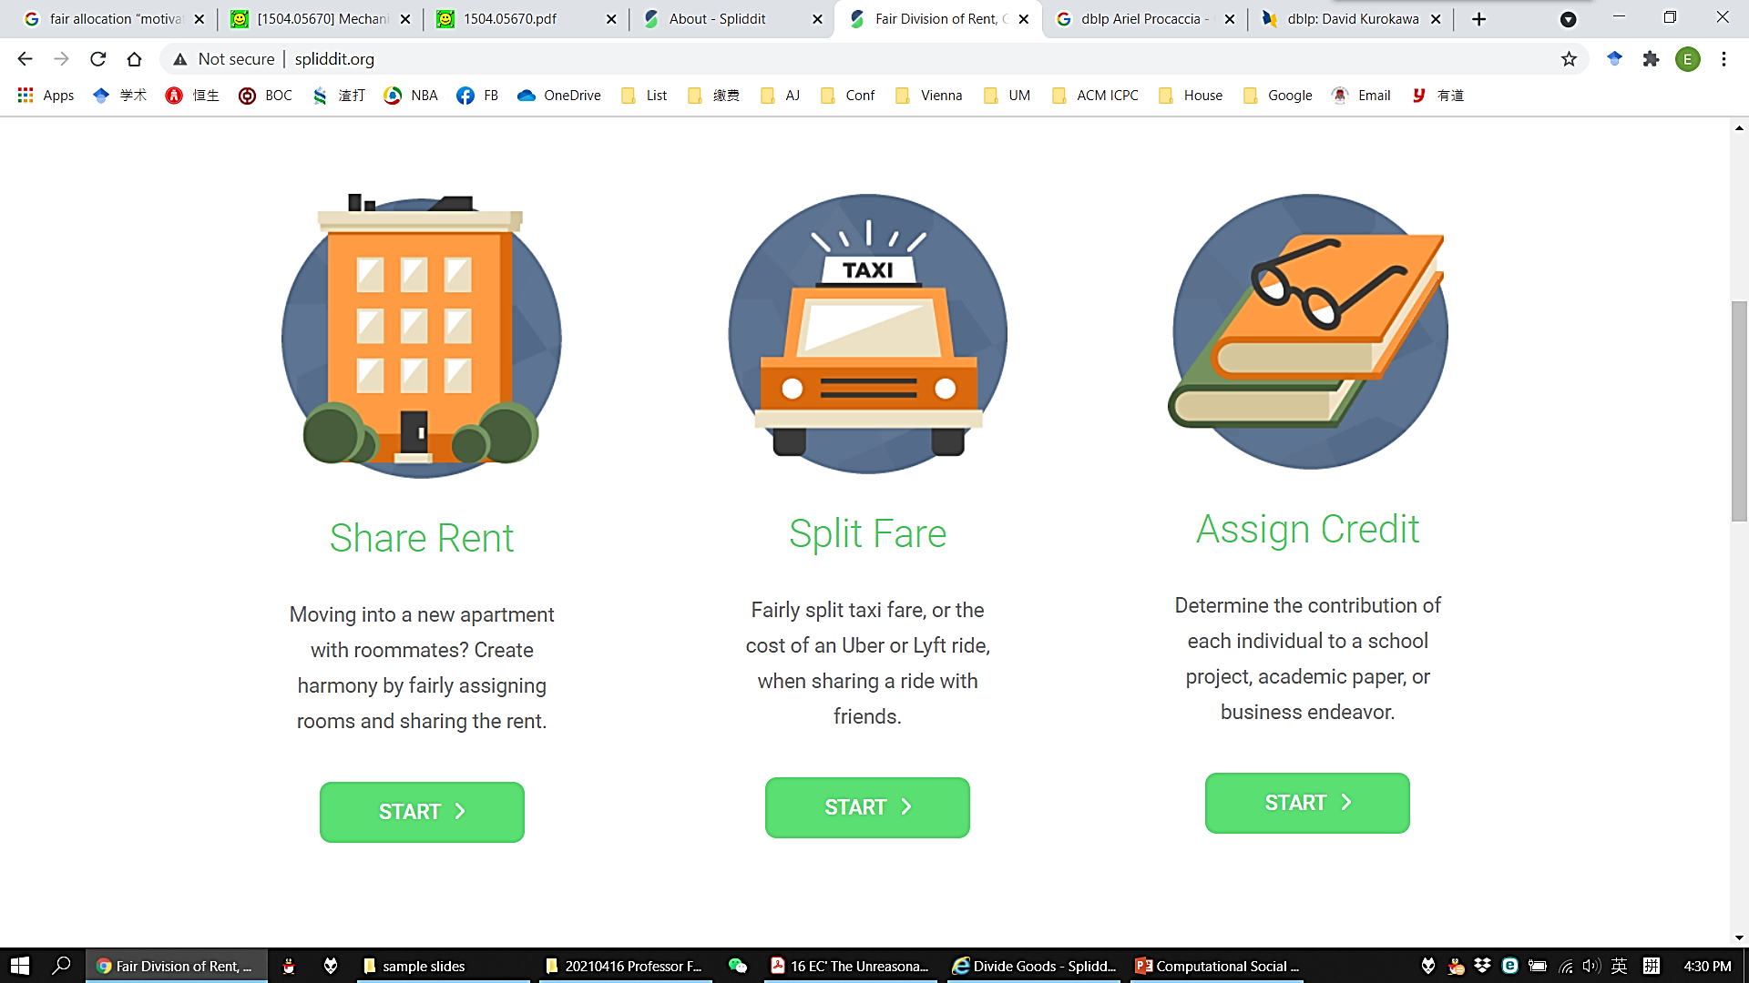
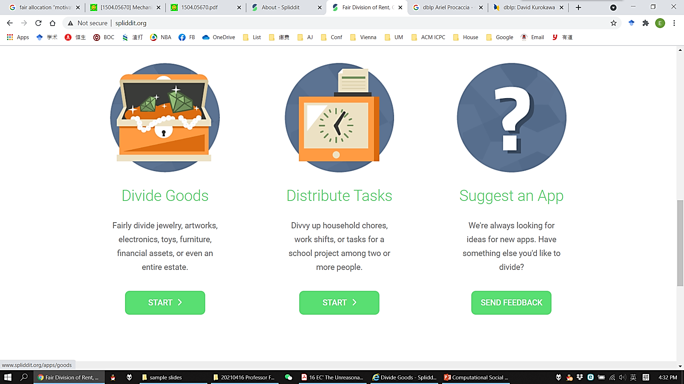


Slide 43
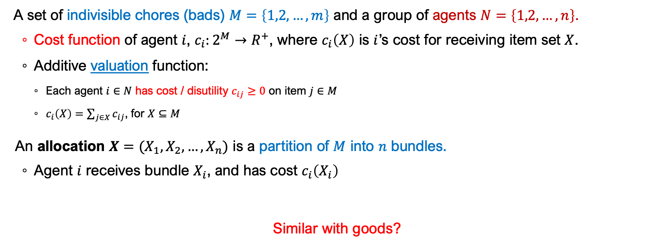
Chores
A set of indivisible chores (bads) $M=\left\{1,2,…,m\right\}$ and a group of agents $N=\left\{1,2,…,n\right\}$.
Cost function of agent $i$, $c_{i}:2^{M}→R^{+}$, where $c_{i}\left(X\right)$ is $i$’s cost for receiving item set $X$.
Additive valuation function:
Each agent $i∈N$ has cost / disutility $c_{ij}≥0$ on item $j∈M$
$c_{i}\left(X\right)=\sum_{j∈X}{c_{ij}}$, for $X⊆M$
An allocation $X=(X_{1},X_{2},…,X_{n})$ is a partition of $M$ into $n$ bundles.
Agent $i$ receives bundle $X_{i}$, and has cost $c_{i}\left(X_{i}\right)$
Similar with goods?

Slide 44
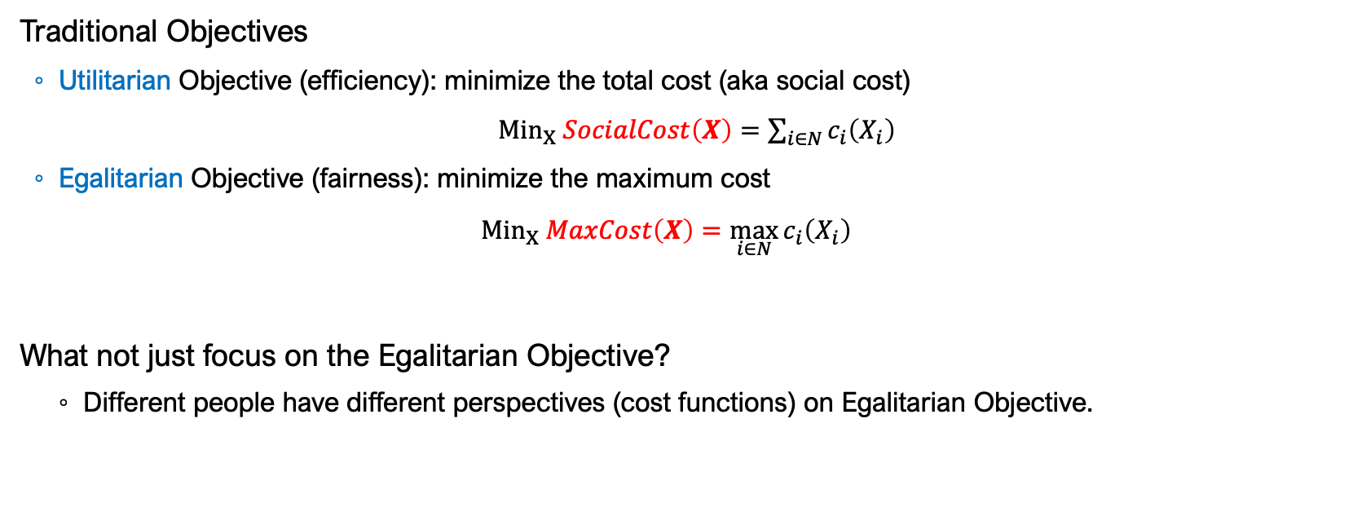
Chores
Traditional Objectives
Utilitarian Objective (efficiency): minimize the total cost (aka social cost)
${Min}_{X} SocialCost\left(X\right)=\sum_{i∈N}{c_{i}\left(X_{i}\right)}$
Egalitarian Objective (fairness): minimize the maximum cost
$${Min}_{X} MaxCost\left(X\right)=\max_{i∈N}{c_{i}\left(X_{i}\right)}$$
What not just focus on the Egalitarian Objective?
Different people have different perspectives (cost functions) on Egalitarian Objective.

Slide 45
The Study on Fair Allocations
Two main problems:
Conceptual work: to measure fairness
Algorithmic work: to compute fair allocations
Research area that intersects with
Computer Science
Mathematics
Social Science and Economics
CS
Math
SoS
Eco

Slide 46
Fairness Notions
EF
PROP
Envy-Free
Proportional

Slide 47
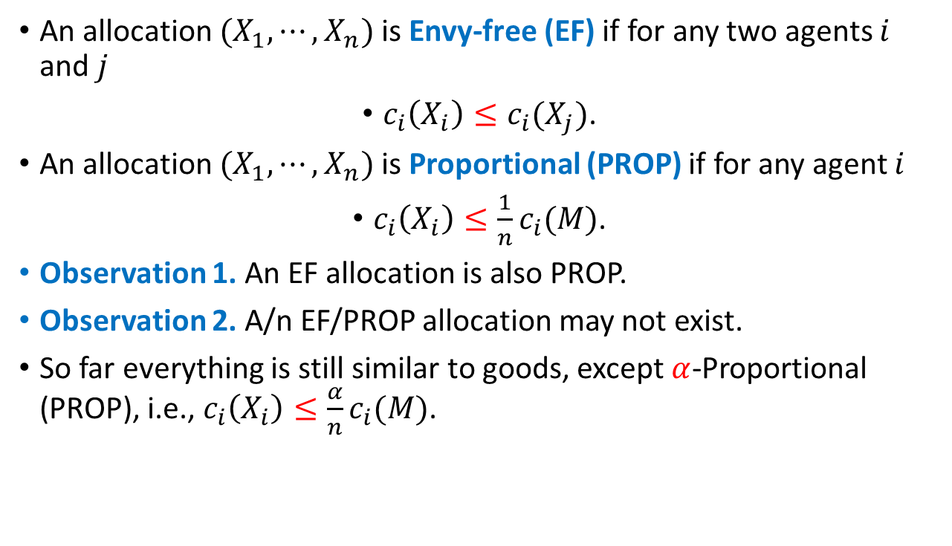
Solution Concepts
An allocation ${(X}_{1},⋯,X_{n})$ is Envy-free (EF) if for any two agents $i$ and $j$
$c_{i}\left(X_{i}\right)≤c_{i}(X_{j})$.
An allocation ${(X}_{1},⋯,X_{n})$ is Proportional (PROP) if for any agent $i$
$c_{i}\left(X_{i}\right)≤\frac{1}{n}c_{i}(M)$.
Observation 1. An EF allocation is also PROP.
Observation 2. A/n EF/PROP allocation may not exist.
So far everything is still similar to goods, except $α$-Proportional (PROP), i.e., $c_{i}\left(X_{i}\right)≤\frac{α}{n}c_{i}(M)$.

Slide 48
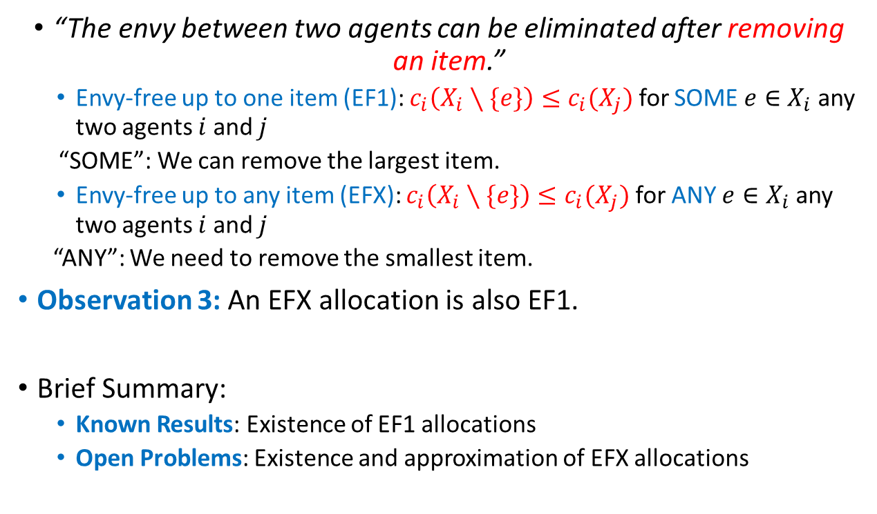
Relaxations for EF
“The envy between two agents can be eliminated after removing an item.”
Envy-free up to one item (EF1): $c_{i}\left(X_{i}∖\{e\}\right)≤c_{i}(X_{j})$ for SOME $e∈X_{i}$ any two agents $i$ and $j$
“SOME”: We can remove the largest item.
Envy-free up to any item (EFX): $c_{i}\left(X_{i}∖\{e\}\right)≤c_{i}(X_{j})$ for ANY $e∈X_{i}$ any two agents $i$ and $j$
“ANY”: We need to remove the smallest item.
Observation 3: An EFX allocation is also EF1.
Brief Summary:
Known Results: Existence of EF1 allocations
Open Problems: Existence and approximation of EFX allocations

Slide 49





EF1 Algorithms
Round Robin (Draft Algorithm)
Each agent takes turns to select a smallest item (in her own perspective).

Slide 50
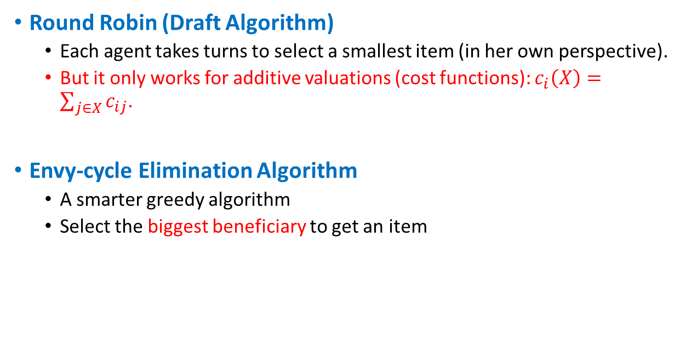
EF1 Algorithms
Round Robin (Draft Algorithm)
Each agent takes turns to select a smallest item (in her own perspective).
But it only works for additive valuations (cost functions): $c_{i}\left(X\right)=\sum_{j∈X}{c_{ij}}$.
Envy-cycle Elimination Algorithm
A smarter greedy algorithm
Select the biggest beneficiary to get an item

Slide 51
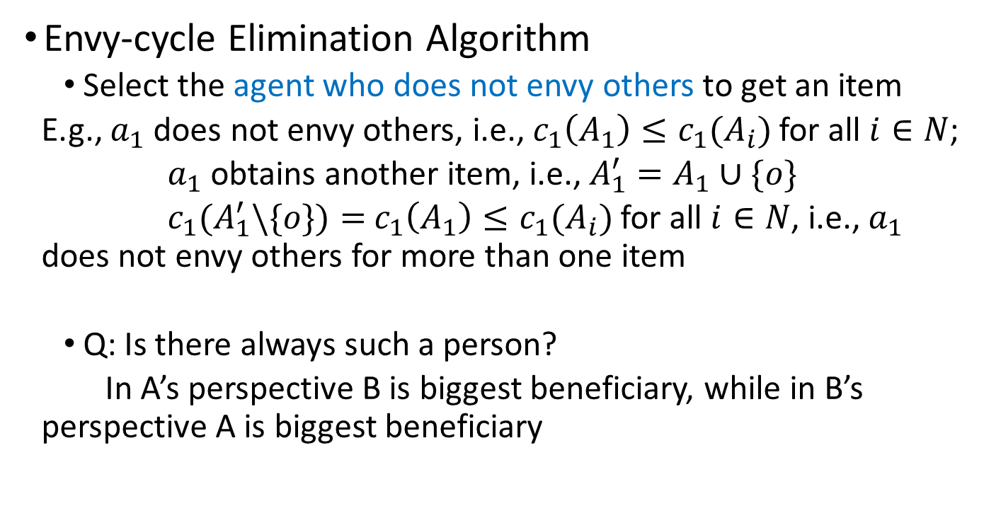
EF1 Algorithms
Envy-cycle Elimination Algorithm
Select the agent who does not envy others to get an item
E.g., $a_{1}$ does not envy others, i.e., $c_{1}\left(A_{1}\right)≤c_{1}(A_{i})$ for all $i∈N$;
$a_{1}$ obtains another item, i.e., $A_{1}^{′}=A_{1}∪\{o\}$
$c_{1}(A_{1}^{′}\backslash \{o\})=$ $c_{1}\left(A_{1}\right)≤c_{1}(A_{i})$ for all $i∈N$, i.e., $a_{1}$ does not envy others for more than one item
Q: Is there always such a person?
In A’s perspective B is biggest beneficiary, while in B’s perspective A is biggest beneficiary

Slide 52
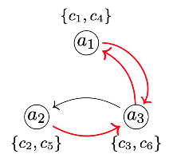
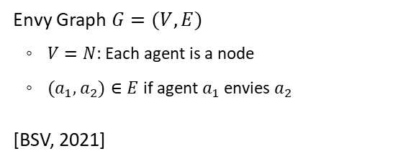
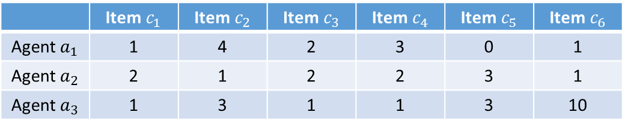
EF1 Algorithms
 | Item $c_{1}$ | Item $c_{2}$ | Item $c_{3}$ | Item $c_{4}$ | Item $c_{5}$ | Item $c_{6}$
Agent $a_{1}$ | 1 | 4 | 2 | 3 | 0 | 1
Agent $a_{2}$ | 2 | 1 | 2 | 2 | 3 | 1
Agent $a_{3}$ | 1 | 3 | 1 | 1 | 3 | 10
Envy Graph $G=(V,E)$
$V=N$: Each agent is a node
${(a}_{1},a_{2})∈E$ if agent $a_{1}$ envies $a_{2}$
[BSV, 2021]

Slide 53
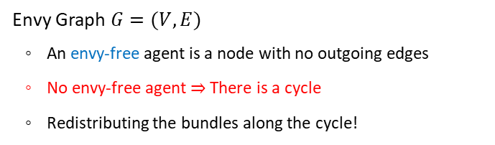
EF1 Algorithms
 | Item $c_{1}$ | Item $c_{2}$ | Item $c_{3}$ | Item $c_{4}$ | Item $c_{5}$ | Item $c_{6}$
Agent $a_{1}$ | 1 | 4 | 2 | 3 | 0 | 1
Agent $a_{2}$ | 2 | 1 | 2 | 2 | 3 | 1
Agent $a_{3}$ | 1 | 3 | 1 | 1 | 3 | 10
Envy Graph $G=(V,E)$
An envy-free agent is a node with no outgoing edges
No envy-free agent $⇒$ There is a cycle
Redistributing the bundles along the cycle!

Slide 54
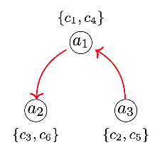

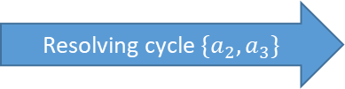
EF1 Algorithms
 | Item $c_{1}$ | Item $c_{2}$ | Item $c_{3}$ | Item $c_{4}$ | Item $c_{5}$ | Item $c_{6}$
Agent $a_{1}$ | 1 | 4 | 2 | 3 | 0 | 1
Agent $a_{2}$ | 2 | 1 | 2 | 2 | 3 | 1
Agent $a_{3}$ | 1 | 3 | 1 | 1 | 3 | 10
Resolving cycle $\{a_{2},a_{3}\}$
For Goods

Slide 55
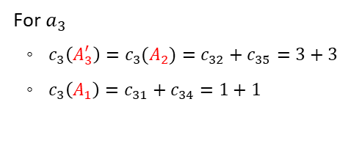
EF1 Algorithms
 | Item $c_{1}$ | Item $c_{2}$ | Item $c_{3}$ | Item $c_{4}$ | Item $c_{5}$ | Item $c_{6}$
Agent $a_{1}$ | 1 | 4 | 2 | 3 | 0 | 1
Agent $a_{2}$ | 2 | 1 | 2 | 2 | 3 | 1
Agent $a_{3}$ | 1 | 3 | 1 | 1 | 3 | 10
For $a_{3}$
$c_{3}\left(A_{3}^{′}\right)=c_{3}(A_{2})=c_{32}+c_{35}=3+3$
$c_{3}\left(A_{1}\right)=c_{31}+c_{34}=1+1$
Not enough for chores

Slide 56
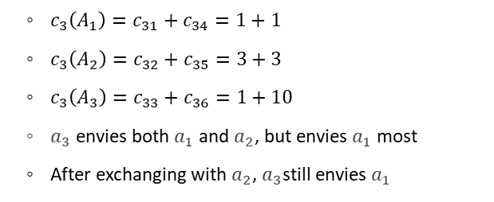
EF1 Algorithms
 | Item $c_{1}$ | Item $c_{2}$ | Item $c_{3}$ | Item $c_{4}$ | Item $c_{5}$ | Item $c_{6}$
Agent $a_{1}$ | 1 | 4 | 2 | 3 | 0 | 1
Agent $a_{2}$ | 2 | 1 | 2 | 2 | 3 | 1
Agent $a_{3}$ | 1 | 3 | 1 | 1 | 3 | 10
$c_{3}\left(A_{1}\right)=c_{31}+c_{34}=1+1$
$c_{3}\left(A_{2}\right)=c_{32}+c_{35}=3+3$
$c_{3}\left(A_{3}\right)=c_{33}+c_{36}=1+10$
$a_{3}$ envies both $a_{1}$ and $a_{2}$, but envies $a_{1}$ most
After exchanging with $a_{2}$, $a_{3}$still envies $a_{1}$

Slide 57



EF1 Algorithms
 | Item $c_{1}$ | Item $c_{2}$ | Item $c_{3}$ | Item $c_{4}$ | Item $c_{5}$ | Item $c_{6}$
Agent $a_{1}$ | 1 | 4 | 2 | 3 | 0 | 1
Agent $a_{2}$ | 2 | 1 | 2 | 2 | 3 | 1
Agent $a_{3}$ | 1 | 3 | 1 | 1 | 3 | 10
Resolving the TOP cycle!
${(a}_{1},a_{2})∈E$ if agent $a_{1}$
envies $a_{2}$ MOST

Slide 58
EF1 Algorithms
Theorem 1. [BSV, 2021]
Top-Envy-Cycle-Elimination Algorithm always returns an EF1 allocation for monotone and combinatorial cost functions.

Slide 59

EFX Allocations
Open Problem 1: The existence of EFX allocation (even for additive cost functions).
Open Problem 2: Approximation algorithms for EFX allocation (even for additive cost functions).
EFX allocations exist if the valuations belong to one of the following cases:
$n=2$
Identical valuations
Binary additive: $c_{ij}∈\{0,1\}$ for all $i$ and $j$
Identical Ordinal (IDO): $c_{i1}≥c_{i2}≥⋯≥c_{im}$ for all $i$

Slide 60


Identical Ordinal (IDO) Instances
IDO: Everyone agrees on a single ranking of all items: $c_{i1}≥c_{i2}≥⋯≥c_{im}$ for all $i$.
Why does Top-Envy-Cycle-Elimination return an EFX allocation?
We force the agents to select largest remaining item in each round.
The newly added item is the smallest.
$$I$$ | Item $c_{1}$ | Item $c_{2}$ | Item $c_{3}$ | Item $c_{4}$ | Item $c_{5}$ | Item $c_{6}$
Agent $a_{1}$ | 4 | 3 | 2 | 1 | 1 | 0
Agent $a_{2}$ | 3 | 2 | 2 | 2 | 1 | 1
Agent $a_{3}$ | 10 | 3 | 1 | 1 | 1 | 1

Slide 61

PROP1 and PROPX
An allocation ${(X}_{1},⋯,X_{n})$ is Proportional (PROP) if for any agent $i$,
$c_{i}\left(X_{i}\right)≤\frac{1}{n}c_{i}\left(M\right)=PROP_{i}$.
Proportional up to one item (PROP1): $c_{i}\left(X_{i}\backslash \{e\}\right)≤\frac{1}{n}c_{i}(M)=PROP_{i}$ for SOME $e∈X_{i}$.
Proportional up to any item (PROPX): $c_{i}\left(X_{i}\backslash \{e\}\right)≤\frac{1}{n}c_{i}(M)=PROP_{i}$ for ANY $e∈X_{i}$.
Observation 4: A PROPX allocation is also PROP1.
Existence for PROPX allocations for additive valuations [LLW, 2021].

Slide 62


PROPX
Lemma 1* (We will see this lemma several times)
If we have an algorithm that returns a PROPX allocation for IDO instance, we can design another algorithm for general instances.
$$I$$ | Item $c_{1}$ | Item $c_{2}$ | Item $c_{3}$ | Item $c_{4}$ | Item $c_{5}$ | Item $c_{6}$
Agent $a_{1}$ | 1 | 4 | 2 | 3 | 0 | 1
Agent $a_{2}$ | 2 | 1 | 2 | 2 | 3 | 1
Agent $a_{3}$ | 1 | 3 | 1 | 1 | 3 | 10
$$I′$$ | Item $c_{1}^{′}$ | Item $c_{2}^{′}$ | Item $c_{3}^{′}$ | Item $c_{4}^{′}$ | Item $c_{5}^{′}$ | Item $c_{6}^{′}$
Agent $a_{1}$ | 4 | 3 | 2 | 1 | 1 | 0
Agent $a_{2}$ | 3 | 2 | 2 | 2 | 1 | 1
Agent $a_{3}$ | 10 | 3 | 1 | 1 | 1 | 1

Slide 63
PROPX
Facts:
It suffices to focus on IDO instances.
For IDO instances, Top-Envy-Cycle-Elimination algorithm returns an EFX allocation.
Lemma 2.
Any EFX allocation is PROPX.
Theorem 3.
PROPX allocations exist and can be found by Top-Envy-Cycle-Elimination algorithm.

Slide 64

PROPX
Lemma 2.
Any EFX allocation is PROPX.
For any EFX allocation $X$ and any agent $i$,
$c_{i}(X_{i}\backslash \{e\})≤$ $c_{i}(X_{j})$ for all $j≠i$,
$c_{i}(X_{i}\backslash \{e\})≤$ $c_{i}(X_{i})$.
Sum them up
${n⋅c}_{i}(X_{i}\backslash \{e\})≤$ $c_{i}(M)$. ◻︎
Do we really need Top-Envy-Cycle-Elimination?

Slide 65



PROPX: A Simple Algorithm
$c_{i1}≥c_{i2}≥⋯≥c_{im}$: Move until reach $PROP_{i}$ + Round-Up
Agent 1
$$c_{1}\left(X_{3}\right)≥PROP_{1}$$
Agent 2
$$c_{2}\left(X_{3}\right)≥PROP_{2}$$
Agent 3
$c_{3}\left(X_{3}\backslash \{e_{3}\}\right)≤PROP_{3}, e_{3}$ is the smallest in $X_{3}$
For agent $i∈\{1,2\}$, remaining items $M\backslash X_{3}$,
$$c_{i}\left(M\backslash X_{3}\right)≤c_{i}\left(M\right)−PROP_{i}=2⋅PROP_{i}.$$

Slide 66



PROPX: A Simple Algorithm
$c_{i1}≥c_{i2}≥⋯≥c_{im}$: Move until reach $PROP_{i}$ + Round-Up
Agent 1
Agent 2
$c_{2}\left(X_{2}\backslash \{e_{7}\}\right)≤PROP_{2}, e_{7}$ is the smallest in $X_{2}$
$c_{1}\left(X_{2}\right)≥PROP_{1}$ and thus $c_{1}\left(X_{1}\right)≤PROP_{1}$
Theorem $3′$. (Will go back)
PROPX allocations exist and can be found by *Moving Knife Algorithm*.

Slide 67

PROPX: The Third Algorithm
$c_{i1}≥c_{i2}≥⋯≥c_{im}$: Allocate each item to the lowest bidder $i$ until passing $PROP_{i}=\frac{1}{n}$
Agent 1
Agent 2
Agent 3
$X_{2}=\{e_{2},e_{4},e_{5}\}$, $c_{2}\left(X_{2}\backslash \{e_{5}\}\right)<\frac{1}{3}$, $c_{2}\left(X_{2}\right)≥\frac{1}{3}$.
For $i∈\{1,3\}$, $c_{i}\left(X_{2}\right)≥c_{2}\left(X_{2}\right)≥\frac{1}{3}$

Slide 68

PROPX: The Third Algorithm
$c_{i1}≥c_{i2}≥⋯≥c_{im}$: Allocate each item to the lowest bidder $i$ until passing $PROP_{i}=\frac{1}{n}$
Agent 1
Agent 2
Agent 3
Theorem $3′′$ (Will go back later).
PROPX allocations exist and can be found by *Bid-and-Take Algorithm*.

Slide 69

Maximin Share
An allocation ${(X}_{1},⋯,X_{n})$ is Proportional (PROP) if for any agent $i$, $c_{i}\left(X_{i}\right)≤\frac{1}{n}c_{i}\left(M\right)=PROP_{i}$.
An imaginary experiment: Agent $i$ divides $M$ into $n$ bundles but is always the last one to select a bundle.
For any partition, the largest one is at least the average, i.e., $PROP_{i}$.
However, $PROP_{i}$ cannot be always guaranteed.
Maximin Share (MMS)*:
$Π\left(M,n\right)$ is the set of all possible $n$-partitions of $M$
$$MMS_{i}=\min_{\left(X_{1},⋯,X_{n}\right)∈Π}{\max_{j∈[n]}{c_{i}(X_{j})}}.$$
$MMS_{i}≥PROP_{i}$ $⇒$Relaxation
An allocation ${(X}_{1},⋯,X_{n})$ is MMS fair if for any agent $i$, $c_{i}\left(X_{i}\right)≤MMS_{i}$.

Slide 70

Maximin Share
An allocation ${(X}_{1},⋯,X_{n})$ is MMS fair if for any agent $i$, $c_{i}\left(X_{i}\right)≤MMS_{i}$.
Not guaranteed to exist [ARSW, 2017]
Method: Design an instance and *enumerate all possible allocations* such that none is MMS.
An allocation ${(X}_{1},⋯,X_{n})$ is $α$-approximate MMS fair ($α$-MMS ) if for any agent $i$,
$c_{i}\left(X_{i}\right)≤α⋅MMS_{i}$ for some $α≥1$.
Lemma 2. [LLW, 2021]
(1) A PROPX allocation is 2-MMS;
(2) An MMS allocation can be $Θ(n)$-PROPX.

Slide 71

Maximin Share
Corollary 1.
Top-Envy-Cycle-Elimination, Moving Knife, and Bid-and-Take returns a 2-MMS allocation.
Lemma 3. [ARSW, 2017]
Round-Robin returns a $(2−\frac{1}{n})$-MMS allocation.
Lemma 4. [BM, 2017]
Top-Envy-Cycle-Elimination actually returns a 4/3-MMS allocation.
Can we improve 4/3-approximation?

Slide 72

Maximin Share
Theorem 4. [Huang and Lu, 2021]
There is 11/9-MMS allocation.
Lemma 1*
If we have an algorithm that returns a PROPX allocation for IDO instance, we can design another algorithm for general instances.
If we have an algorithm that returns an $α$-approximate MMS allocation for IDO instance, we can design another algorithm for general instances.
It suffices to focus on IDO instances.

Slide 73

Maximin Share
Theorem 4. [Huang and Lu, 2021]
There is 11/9-MMS allocation.
Recall Moving-Knife Algorithm
$c_{i1}≥c_{i2}≥⋯≥c_{im}$: Move until not PROPX for all
Agent 1
“Move” $⇒$ A Bag
From left to right, when reaching item $j$, as long as adding $j$ to the bag fits at least one agent’s PROPX, add $j$.
Agent 2
Agent 3

Slide 74

Maximin Share
Theorem 4. [Huang and Lu, 2021]
There is 11/9-MMS allocation.
Recall Moving-Knife Algorithm
$c_{i1}≥c_{i2}≥⋯≥c_{im}$: Move until not PROPX for all
Agent 1
The bag immediately stops adding items when adding $j$ does not fit* anyone.
Why not skip this $j$?
Agent 2
Agent 3

Slide 75

Maximin Share
Theorem 4. [Huang and Lu, 2021]
There is 11/9-MMS allocation.
1
$c_{i1}≥c_{i2}≥⋯≥c_{im}$: Move until not MMS for everyone
From left to right, when reaching item $j$, as long as adding $j$ to the bag fits at least one agent’s MMS, add $j$.
Otherwise, skip $j$ and consider $j+1$
2

Slide 76

Maximin Share
Theorem 4. [Huang and Lu, 2021]
There are 11/9-MMS allocations.
However, there might be some items unallocated!
Relax $MMS$ to $α$-MMS until all items can be allocated.
[Huang and Lu, 2021] showed that setting $α=11/9$ will be enough.
$c_{i1}≥c_{i2}≥⋯≥c_{im}$: Move until not MMS for everyone
Open problem:
11/9 is not tight!

Slide 77

Partial Information
Complete Information: Cardinal valuations, $\left(c_{i1},⋯,c_{im}\right)∈R^{n}$ for all agent $i$;
Partial Information: Ordinal valuations, $c_{i1}≥⋯≥c_{im}$ for all agent $i$;
Note they do have cardinal valuations; just we do not know.
Observations:
Envy-Cycle-Elimination, Moving-Knife, Bid-and-Take, …, they use cardinal valuations.
They need to compute $c_{i}(X)$ for some $X$.
Round-Robin only uses ordinal valuations.
The agents follow a prefixed order to select items.

Slide 78

MMS Fairness via Ordinal Information
Why isn’t ordinal information enough?
Consider a simple example with two agents and four items.
We only need to consider IDO instances: $c_{i1}≥c_{i2}≥c_{i3}≥c_{i4}$ for $i∈\{1,2\}$.
The cardinal valuations can be arbitrary that are consistence with the ranking.
Wlog, assume item 1 is allocated to agent 1.
If agent 1 only receives 1 item, consider valuation $c_{2}=(1,1,1,1)$ where $c_{2}\left(X_{2}\right)=3$ while $MMS_{2}=2$.
Thus, the approximation ratio cannot be better (smaller) than 3/2.
If agent 1 receives 2 items, consider valuation $c_{1}=(3,1,1,1)$ where $c_{1}\left(X_{1}\right)=4$ while $MMS_{1}=3$.
Thus, the approximation ratio cannot be better (smaller) than 4/3.

Slide 79

MMS Fairness via Ordinal Information
Wlog, assume item 1 is allocated to agent 1.
If agent 1 only receives 1 item, consider valuation $c_{2}=(1,1,1,1)$ where $c_{2}\left(X_{2}\right)=3$ while $MMS_{2}=2$.
Thus, the approximation ratio cannot be better (smaller) than 3/2.
If agent 1 receives 2 item, consider valuation $c_{1}=(3,1,1,1)$ where $c_{1}\left(X_{1}\right)=4$ while $MMS_{2}=3$.
Thus, the approximation ratio cannot be better (smaller) than 4/3.
Recall with cardinal valuations, there are 11/9-MMS allocations.
Cardinal valuations are strictly more powerful than ordinal valuations.
The lower bound 4/3 quantifies the gap between cardinal and ordinal valuations.

Slide 80

MMS Fairness via Ordinal Information
Theorem 5. [ALW, 2021]
No deterministic ordinal algorithm has approximation ratio (w.r.t. MMS) smaller than
4/3=1.33 for $n=2$;
7/5=1.4 for $n=3$;
1.405 for $n≥4$.
We cannot be better, but can we be the same?
Almost!
Design good ordinal algorithms.

Slide 81







MMS Fairness via Ordinal Information
Round-Robin Algorithm?
Round-Robin guarantees 3/2-approximation.
Round-Robin has a repeated pre-fixed picking sequence ${\left[a_{2},a_{1}\right]}^{∗}$, and agent $a_{1}$ has advantage.
Possible improvement: $a_{1}$ should select more items than $a_{2}$.
Why not ${\left[a_{2},a_{1},a_{1}\right]}^{∗}$?
$$c_{i1}≥c_{i2}≥c_{i3}≥c_{i4}≥c_{i5}≥c_{i6}$$
$$I$$ | Item $c_{1}$ | Item $c_{2}$ | Item $c_{3}$ | Item $c_{4}$ | Item $c_{5}$ | Item $c_{6}$
Allocation
$$a_{2}$$
$$a_{1}$$
$$a_{2}$$
$$a_{1}$$
$$a_{2}$$
$$a_{1}$$
$$I$$ | Item $c_{1}$ | Item $c_{2}$ | Item $c_{3}$ | Item $c_{4}$ | Item $c_{5}$ | Item $c_{6}$
Allocation
$$a_{2}$$
$$a_{1}$$
$$a_{1}$$
$$a_{2}$$
$$a_{1}$$
$$a_{1}$$

Slide 82

MMS Fairness via Ordinal Information
Theorem 6. [ALW, 2021]
${\left[1,2,2\right]}^{∗}$ returns a 4/3-MMS allocation for $n=2$.
Thus, this is the optimal ordinal algorithm for $n=2$.
${\left[1,2,3,3,2\right]}^{∗}$ returns a 7/5-MMS allocation for $n=3$.
Thus, this is the optimal ordinal algorithm for $n=3$.
${\left[1,⋯,n,n,n−1,⋯, \left\lfloor \frac{n}{2}\right\rfloor +1\right]}^{∗}$ returns a 5/3-MMS allocation for $n≥4$.
Thus, this is not optimal, 5/3 $≈$1.667>1.405.
Open Question: Close the approximation gap for $n≥4$.

Slide 83


Strategyproof Algorithms
We know nothing about the agents’ preferences, even ordinal valuations.
Mechanism Design Problem
Strategyproof (truthful) Algorithm: reporting true valuations is dominant strategy.
Method: Agents cannot benefit by lying, no matter who the other agents are.
Round-Robin is not strategyproof:
$$I$$ | Item $c_{1}$ | Item $c_{2}$ | Item $c_{3}$
Agent $a_{1}$ | 1 | 2 | 3
Agent $a_{2}$ | 3 | 1 | 2
$$I$$ | Item $c_{1}$ | Item $c_{2}$ | Item $c_{3}$
Agent $a_{1}$ | 2 | 1 | 3
Agent $a_{2}$ | 3 | 1 | 2
True valuation
False valuation

Slide 84

Strategyproof Algorithms
Learned:
It is strategyproof if each agent only has one chance to select items.
Consecutive Picking algorithm
Fix a sequence of integers: $k_{1},k,…,k_{n}$ such that
$$k_{1}+k_{2}+…+k_{n}=m.$$
For $i=1,2,…,n$, let agent $i$ pick $k_{i}$ items from the remaining items.
Intuition: to guarantee fairness $k_{1}≥k_{2}≥…≥k_{n}≥0$.
More concrete: to ensure $α$-approximation
$\frac{k_{i}}{m_{i}}≤\frac{α}{n}$, for all $i∈N$,
$m_{i}$ is the number of remaining item when $i$ chooses.

Slide 85

Strategyproof Algorithms
Theorem 7. [ALW, 2019]
The “optimal” approximation ratio guaranteed by Consecutive Picking Algorithms is $O(\log{\frac{m}{n}})$.
Open Problem: Designing SP mechanisms with better approximation.
Hardness: We do not know how to use cardinal information in an SP way.
Theorem 8. [ALW, 2019]
There is a randomized algorithm that is SP and achieves $O(\sqrt{\log{n}})$-approximation in expectation.

Slide 86

Asymmetric Agents
Symmetric Agents:
All agents have the same share for items, e.g., $s_{i}=\frac{1}{n}=PROP_{i}$.
We want to allocate the items evenly.
Asymmetric Agents:
Agents may have different shares/weights/endowments for items, e.g., $s_{i}∈[0,1]$ and $\sum_{i}{s_{i}=1}$.
E.g., agent 1 has share 0.5, agent 2 and agent 3 have share 0.25.
We want to allocate the items according to their shares.
An allocation is weighted proportional if $c_{i}\left(X_{i}\right)≤s_{i}$ for all $i$.

Slide 87

Weighted PROPX
An allocation is weighted proportional if $c_{i}\left(X_{i}\right)≤s_{i}$ for all $i$.
An allocation is weighted proportional up to one item (PROP1) if for all $i$,
$c_{i}\left(X_{i}\backslash \{e\}\right)≤s_{i}$ for some $e∈X_{i}$.
I.e., removing the largest item.
An allocation is weighted proportional up to any item (PROPX) if for all $i$,
$c_{i}\left(X_{i}\backslash \{e\}\right)≤s_{i}$ for any $e∈X_{i}$.
I.e., removing the smallest item.

Slide 88

Weighted PROPX
Lemma 1*
If we have an algorithm that returns a PROPX/ $α$-approximate MMS allocation for IDO instance, we can design another algorithm for general instances.
If we have an algorithm that returns a weighted PROPX allocation for IDO instance, we can design another algorithm for general instances.
It suffices to focus on IDO instances.
Recall the “Bid-and-Take” Algorithm.

Slide 89
Weighted PROPX
$c_{i1}≥c_{i2}≥⋯≥c_{im}$: Allocate each item to the lowest bidder $i$ until passing $PROP_{i}=\frac{1}{n}$
Agent 1
Agent 2
Agent 3
Allocate item $j$ to one remaining agent with lowest cost until $c_{i}\left(X_{i}\right)≥\frac{1}{n}$ and remove $i$.

Slide 90
Weighted PROPX
$c_{i1}≥c_{i2}≥⋯≥c_{im}$: Allocate each item to the lowest bidder $i$ until passing $s_{i}$
Agent 1
Agent 2
Agent 3
Allocate item $j$ to one remaining agent with lowest cost until $c_{i}\left(X_{i}\right)≥s_{i}$ and remove $i$.
Theorem 9 [LLW, 2021]
Weighted PROPX allocations exist and can be found by *Bid-and-Take Algorithm*.

Slide 91

Weighted EF1
Agents have weights $s_{i}∈[0,1]$ and $\sum_{i}{s_{i}=1}$.
Weighted EF1: for any $i,j$ and $e∈X_{i}$
$\frac{c_{i}(X_{i}\backslash \{e\})}{s_{i}}≤$ $\frac{c_{i}(X_{j})}{s_{j}}$.
For goods, a weighted EF1 allocation is known to exist [CISZ, 2020],
Open Question: The existence for chores is unknown.

Slide 92

Weighted MMS
Agents have weights $s_{i}∈[0,1]$ and $\sum_{i}{s_{i}=1}$.
The best agent $i$ can guarantee is to
$$F_{i}≜\min_{\left(X_{1},⋯,X_{n}\right)}\max_{j}{\frac{c_{i}(X_{j})}{s_{j}}}$$
Weighted MMS [ACL, 2019] for agent $i$ is
$WMMS_{i}=s_{i}⋅F_{i}$.
An allocation is $α$-approximate weighted MMS if $c_{i}\left(X_{i}\right)≤α⋅WMMS_{i}$ for all $i$.
Open Question: A constant approximation is unknown.
AnyPrice share (APS) [BEF, 2021]

Slide 93
Further Directions
Fair and efficient allocation
Compatibility between fairness and Pareto optimality (PO) [AMS, 2020]
Compute a fair allocation that maximizes social welfare/minimizes social cost [Barmen et al, 2019]
Price of fairness [BLMS, 2019; LWL, 2021]
Constrained Settings
Cardinality, Matroid [BB,2017; DFS,2020]
Knapsack [WLG, 2021]

Slide 94
References
H. Aziz and S. Mackenzie. A discrete and bounded envy-free cake cutting protocol for four agents. STOC 2016.
H. Aziz and S. Mackenzie. A discrete and bounded envy-free cake cutting protocol for any number of agents. FOCS 2016.
I. Caragiannis, N. Gravin, X. Huang. Envy-freeness up to any item with high Nash welfare: The virtue of donating items. EC 2019.
I. Caragiannis, D. Kurokawa, H. Moulin, A. D. Procaccia, N. Shah, J. Wang. The unreasonable fairness of maximum Nash welfare. EC 2016.
X. Bei, N. Chen, G. Huzhang, B. Tao, and J. Wu. Cake Cutting: Envy and Truth. IJCAI 2017.
X. Bei, G. Huzhang, and W. Suksompong. Truthful Fair Division without Free Disposal. IJCAI 2018.
X. Bei, Z. Li, J. Liu, S. Liu and X Lu. Fair Division of Mixed Divisible and Indivisible Goods. AAAI 2020.
SJ. Brams and AD. Taylor, An envy-free cake division protocol. The American Mathematical Monthly. 1995.
BR. Chaudhury, J. Garg and K. Mehlhorn. EFX Exists for Three Agents. EC 2020.
Y. Chen, J. Lai, D. Parkes, and A. Procaccia. Truth, Justice, and Cake Cutting. AAAI 2010.
D. Kurokawa, J. Lai, and A. Procaccia. How to cut a cake before the party ends. AAAI 2013.
V. Menon and K. Larson. Deterministic, Strategyproof, and Fair Cake Cutting. IJCAI 2017.
B. Plaut and T. Roughgarden. Almost Envy-Freeness with General Valuations. SODA 2018.
B. Tao. On Existence of Truthful Fair Cake Cutting Mechanisms. ArXiv 2104.07387. 2021.

Slide 95
References
Umang Bhaskar, A. R. Sricharan, Rohit Vaish: On Approximate Envy-Freeness for Indivisible Chores and Mixed Resources. CoRR abs/2012.06788 (2020)
Bo Li, Yingkai Li, Xiaowei Wu: Almost Proportional Allocations for Indivisible Chores. CoRR abs/2103.11849 (2021)
Haris Aziz, Gerhard Rauchecker, Guido Schryen, Toby Walsh: Algorithms for Max-Min Share Fair Allocation of Indivisible Chores. AAAI 2017: 335-341
Siddharth Barman, Sanath Kumar Krishna Murthy: Approximation Algorithms for Maximin Fair Division. EC 2017: 647-664
Xin Huang, Pinyan Lu: An algorithmic framework for approximating maximin share allocation of chores. EC 2021

Slide 96
References
Haris Aziz, Bo Li, Xiaowei Wu: Approximate and Strategyproof Maximin Share Allocation of Chores with Ordinal Preferences. CoRR abs/2012.13884 (2020)
Haris Aziz, Bo Li, Xiaowei Wu: Strategyproof and Approximately Maxmin Fair Share Allocation of Chores. IJCAI 2019: 60-66
Haris Aziz, Hau Chan, Bo Li: Weighted Maxmin Fair Share Allocation of Indivisible Chores. IJCAI 2019: 46-52
Bo Li, Yingkai Li, Xiaowei Wu: Almost Proportional Allocations for Indivisible Chores. CoRR abs/2103.11849 (2021)
Moshe Babaioff, Tomer Ezra, Uriel Feige: Fair-Share Allocations for Agents with Arbitrary Entitlements. EC 2021

Slide 97
References
Haris Aziz, Hervé Moulin, Fedor Sandomirskiy: A polynomial-time algorithm for computing a Pareto optimal and almost proportional allocation. Oper. Res. Lett. 48(5): 573-578 (2020)
Siddharth Barman, Ganesh Ghalme, Shweta Jain, Pooja Kulkarni, Shivika Narang: Fair Division of Indivisible Goods Among Strategic Agents. AAMAS 2019: 1811-1813
Xiaohui Bei, Xinhang Lu, Pasin Manurangsi, Warut Suksompong: The Price of Fairness for Indivisible Goods. IJCAI 2019: 81-87
Mithun Chakraborty, Ayumi Igarashi, Warut Suksompong, Yair Zick: Weighted Envy-Freeness in Indivisible Item Allocation. AAMAS 2020: 231-239
Arpita Biswas, Siddharth Barman: Matroid Constrained Fair Allocation Problem. AAAI 2019: 9921-9922

Slide 98
References
Amitay Dror, Michal Feldman, Erel Segal-Halevi: On Fair Division under Heterogeneous Matroid Constraints. AAAI 2021: 5312-5320
Sylvain Bouveret, Katarína Cechlárová, Edith Elkind, Ayumi Igarashi, Dominik Peters: Fair Division of a Graph. IJCAI 2017: 135-141
Hau Chan, Jing Chen, Bo Li, Xiaowei Wu: Maximin-Aware Allocations of Indivisible Goods. IJCAI 2019: 137-143
Haris Aziz, Sylvain Bouveret, Ioannis Caragiannis, Ira Giagkousi, Jérôme Lang: Knowledge, Fairness, and Social Constraints. AAAI 2018: 4638-4645
Hadi Hosseini, Sujoy Sikdar, Rohit Vaish, Hejun Wang, Lirong Xia: Fair Division Through Information Withholding. AAAI 2020: 2014-2021

Slide 99
References
Ioannis Caragiannis, Nick Gravin, Xin Huang: Envy-Freeness Up to Any Item with High Nash Welfare: The Virtue of Donating Items. EC 2019: 527-545
Bhaskar Ray Chaudhury, Telikepalli Kavitha, Kurt Mehlhorn, Alkmini Sgouritsa: A Little Charity Guarantees Almost Envy-Freeness. SODA 2020: 2658-2672
Brandon Fain, Kamesh Munagala, Nisarg Shah: Fair Allocation of Indivisible Public Goods. EC 2018: 575-592
Vincent Conitzer, Rupert Freeman, Nisarg Shah: Fair Public Decision Making. EC 2017: 629-646
Pak Hay Chan, Xin Huang, Zhengyang Liu, Chihao Zhang, Shengyu Zhang: Assignment and Pricing in Roommate Market. AAAI 2016: 446-452

